Slide 1
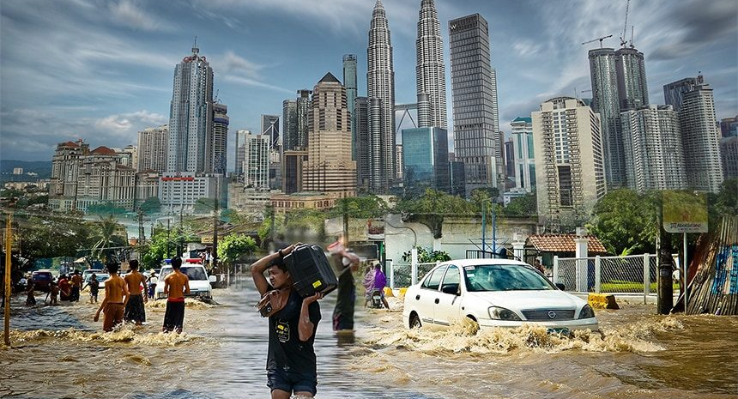
FLOOD FREQUENCY ANALYSIS USING EXTREME VALUE DISTRIBUTION IN PENINSULAR MALAYSIA BASED ON L-MOMENT METHOD
NUR AMIRA BINTI ABDUL AZIZ (2023184923)
SUPERVISOR: DR. BASRI BIN BADYALINA

Slide 2
AGENDA OVERVIEW
03
11-16
BACKGROUND OF STUDY
RESULT OF STUDY
04
17
PROBLEM STATEMENT
CONCLUSION
05
18
METHOD OF ANALYSIS
RECOMMENDATION
06-10
19
METHODOLOGY
REFERENCES

Slide 3
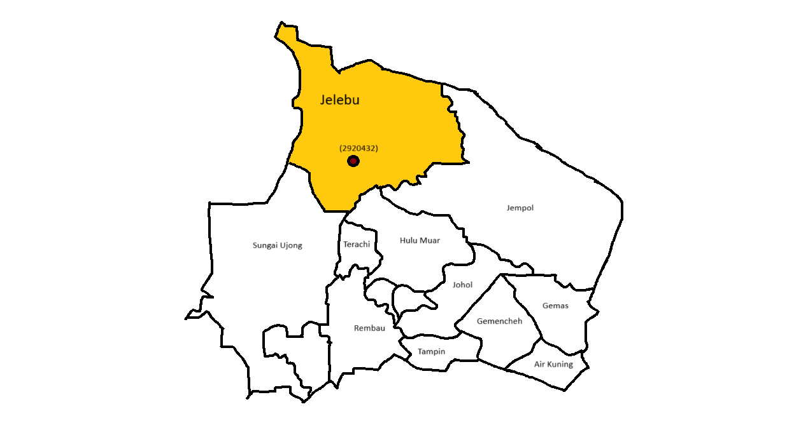

BACKGROUND OF STUDY
Malaysia experienced frequent floods, especially during the monsoon seasons (Southwest: May–Sept; Northeast: Nov–March).
Heavy rainfall during monsoons affecting areas like Kelantan, Terengganu, and Johor.
Floods led to community displacement, damaged infrastructure, and economic loss.
Understanding flood patterns was essential.
This study used 63 years of data and focus on three statistical models including Generalized Extreme Value (GEV), Generalized Pareto (GPA), and Generalized Logistic (GLO) distributions.
03

Slide 4

PROBLEM STATEMENT
Flooding in Peninsular Malaysia was a significant hazard, endangering individuals, infrastructure, and ecosystems.
The increased frequency and severity of floods underscored the urgent need for improved prediction and control strategies.
Flood frequency Analysis (FFA) was a statistical technique used.
L-moments provided a more reliable estimation of probability distributions for extreme events compared to conventional moments.
04

Slide 5
METHOD OF ANALYSIS
Research objectives
Method of Analysis
To develop and evaluate a precise flood frequency model using extreme value distributions for predicting the occurrence and magnitude of floods in Peninsular Malaysia’s river systems.
Ranking the Performance Measure
To utilise L-Moments for the estimation of parameters of extreme value distributions used in modelling flood data.
L-Moment
To estimate the return periods of various flood magnitudes by analysing historical streamflow data and applying extreme value distributions.
Quantile Estimate
05

Slide 6
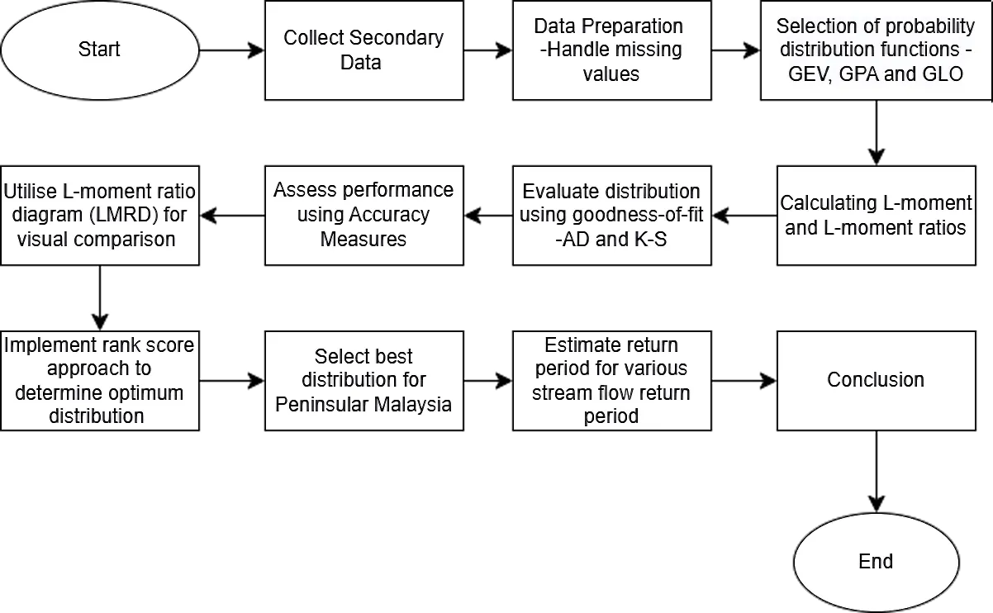
METHODOLOGY
06

Slide 7
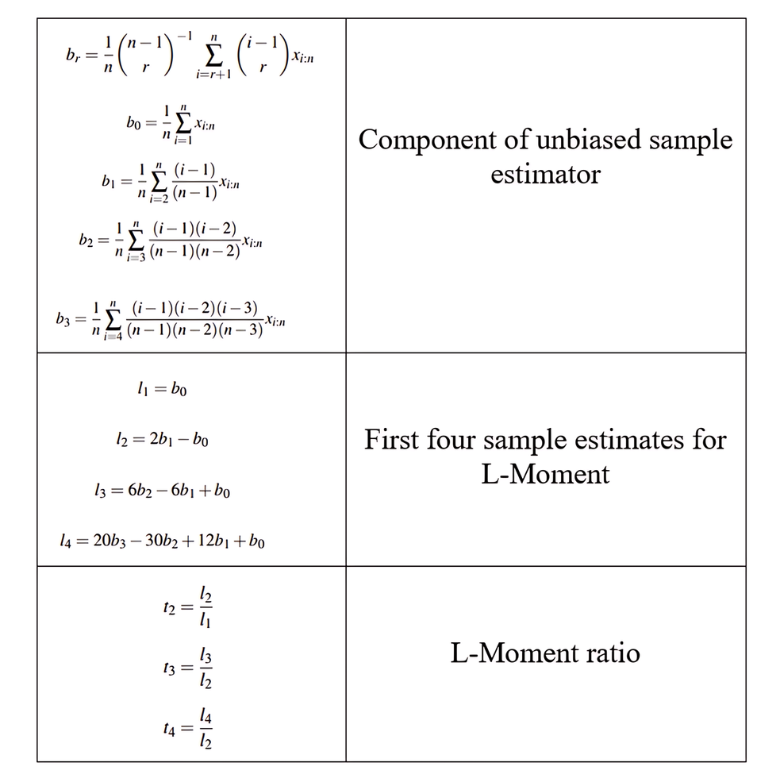
METHODOLOGY
L-MOMENT
The probability weight moment (PWM) generates the L-moment, introduced by J.R. Hosking (1990).
Four unbiased estimator components and the first four sample estimators of L-Moment, derived L-Moment ratios.
07

Slide 8
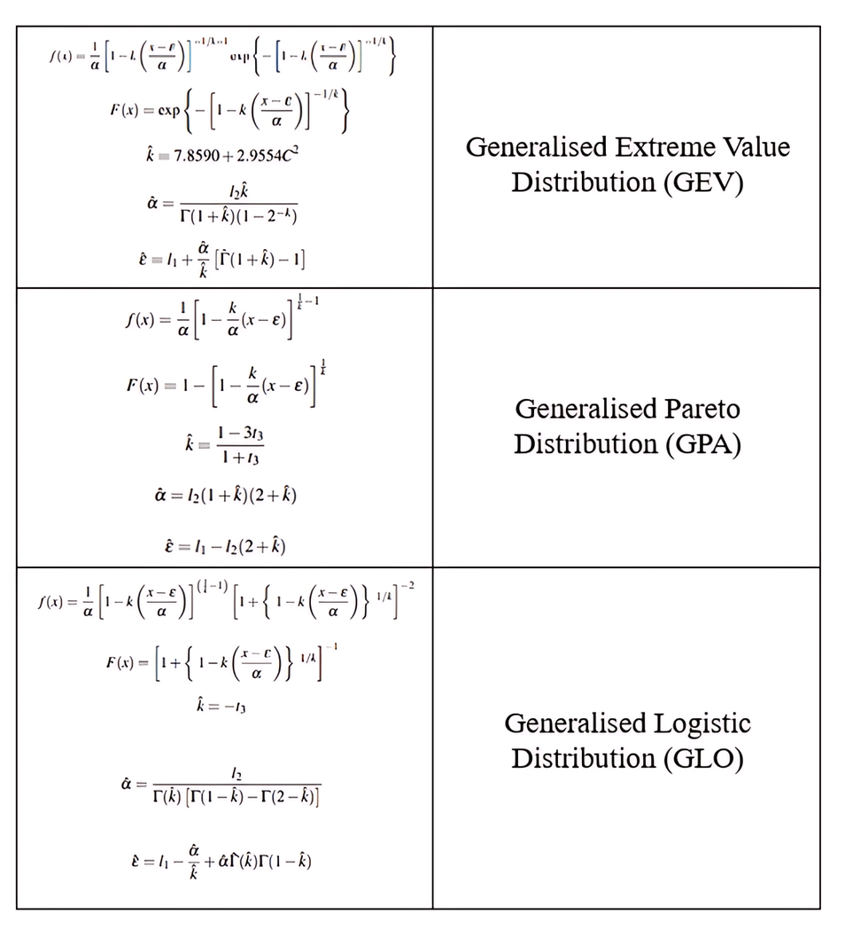



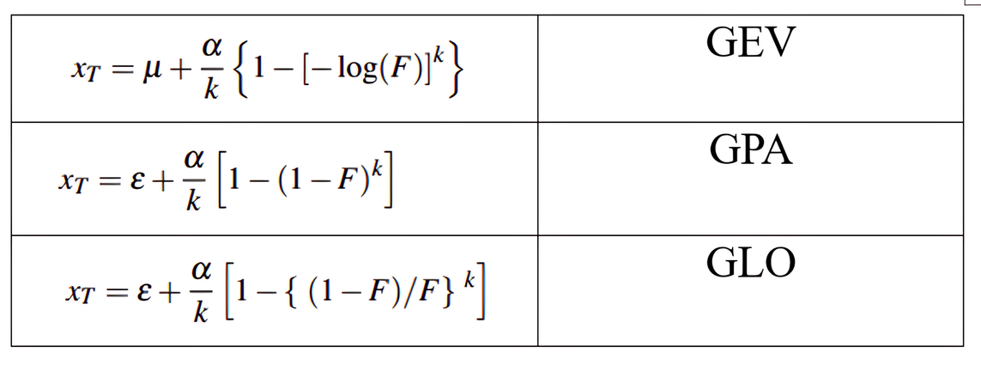
METHODOLOGY
EXTREME VALUE DISTRIBUTION
Hamed & Rao (2019) presented the probability and cumulative density function of the GEV, GPA and GLO distributions.
Utilising three parameters ( , , and ) was possible to calculate the quantile estimate for each distribution based on the return period.
Quantile estimate each distribution:
08

Slide 9
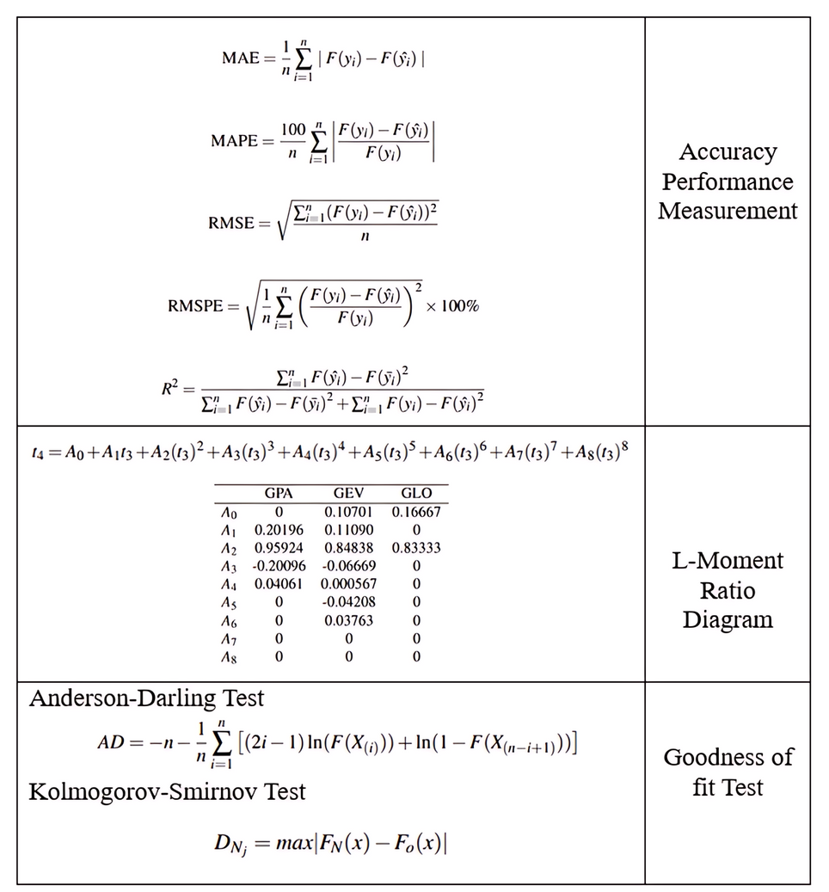

METHODOLOGY
PERFORMANCE MEASUREMENT
Accuracy Performance Measurement: There were five accuracy performance measurement used: the Mean Absolute Percentage Error (MAPE), Mean Absolute Error (MAE), Root Mean Square Error (RMSE), Root Mean Square Percentage Error (RMSPE), Coefficient of Determination ( )
L-Moment Ratio Diagram:
Proposed by Hosking and Wallis (1997) to choose an appropriate distribution that represented the streamflow data.
Each distribution ratio diagram created with L-kurtosis against L-skewness by substituting value of t3 in the t4 calculation.
Goodness of Fit: The Anderson-Darling Test and Kolmogorov-Smirnov Test implied by Hamed & Rao (2019) to evaluate the degree of fit between the distribution and the real dataset.
09

Slide 10
METHODOLOGY
MEASUREMENT RANKING
The ranking was the final stage of implementation in the study.
The distribution with the greatest score (3) was considered the best fit, while the one with the lowest score (1) was considered the least appropriate.
10

Slide 11




RESULT OF STUDY
1. L-MOMENT
L-moment components | L-moment components | L-moment components | L-moment components
4.3715 | 1.6051 | 0.2264 | 0.2398
where, mean ( ), scale ( ), skewness ( ), and kurtosis ( )
The value 0.43715 reflecting the average magnitude of the flood events.
The scale indicates moderate variation in flood magnitudes.
The skewness signifies a positive asymmetry in the data distribution.
The kurtosis signifies light tails in the distribution.
11

Slide 12
2. ESTIMATION PARAMETER
 |  | Parameters
Distribution
GEV | 2.4109 | 3.0840 | 0.0454
GPA | 6.0547 | 0.3498 | 0.5055
GLO | 1.5531 | 4.0027 | -0.1411
where scale parameter ( ), location parameter ( ), and shape parameter ( )
GPA indicate greater variability, range of flood magnitude the widest.
GLO indicate flood magnitude generally high.
GPA suggested heavy tail.
12

Slide 13
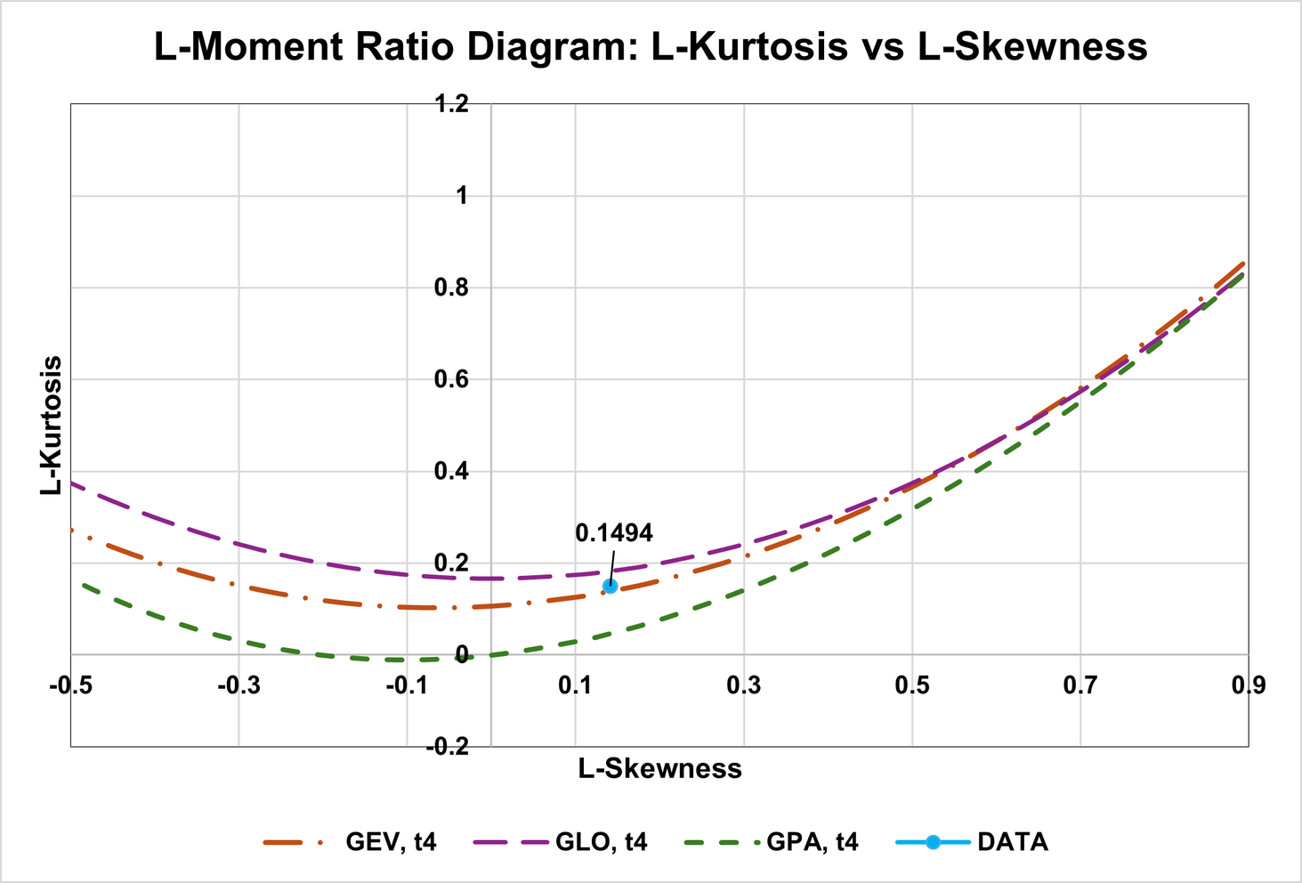
3. L-MOMENT RATIO DIAGRAM
L-CV (t2) | L-Skewness (t3) | L-Kurtosis (t4)
0.3672 | 0.1411 | 0.1494
The candidate distribution for the best distribution is GEV distribution.
13

Slide 14

4. GOODNESS-OF-FIT AND ACCURACY PERFORMANCE MEASURE
Distribution | GEV | GPA | GLO
AD | 0.3979 | 0.000009524 | 0.3684
K-S | 0.4244 | 0.1567 | 0.5923
MAPE | 0.2276 | 0.1271 | 0.3048
MAE | 0.5369 | 0.5827 | 0.5396
RMSE | 0.8883 | 1.1586 | 0.7842
RMSPE | 65.0587 | 19.9394 | 99.9211
 | 0.9180 | 0.8589 | 0.9366
Abbreviation: Anderson Darling (AD), Kolmogorov-Smirnov (K-S) Test, Mean Absolute Percentage Error (MAPE), Mean Absolute Error (MAE), Root Mean Square Error (RMSE), Root Mean Square Percentage Error (RMSPE), Coefficient of Determination ( )
14

Slide 15
5. MEASUREMENT RANKING
Distribution | GEV | GPA | GLO
AD | 3 | 1 | 2
K-S | 2 | 1 | 3
MAPE | 2 | 3 | 1
MAE | 3 | 1 | 2
RMSE | 2 | 1 | 3
RMSPE | 2 | 3 | 1
 | 2 | 1 | 3
Total Score | 16 | 11 | 15
The best distribution is GEV.
15
Abbreviation: Anderson Darling (AD), Kolmogorov-Smirnov (K-S) Test, Mean Absolute Percentage Error (MAPE), Mean Absolute Error (MAE), Root Mean Square Error (RMSE), Root Mean Square Percentage Error (RMSPE), Coefficient of Determination ( )

Slide 16
6. QUANTILE ESTIMATE
Return Period (year) | Probabilities (p) | Estimated Flood Discharge m³/s | Estimated Flood Discharge m³/s | Estimated Flood Discharge m³/s
Return Period (year) | Probabilities (p) | GEV | GPA | GLO
10 | 0.90 | 8.2412 | 8.2280 | 8.3828
50 | 0.98 | 11.7045 | 12.1111 | 10.6525
100 | 0.99 | 13.0923 | 14.0749 | 11.1536
16

Slide 17
CONCLUSION
Highlighted the practical and academic implications of integrating detailed data analysis into flood mitigation and regional planning.
Identified GEV distribution as the most reliable model for predicting flood magnitudes, outperforming other methods in accuracy and goodness-of-fit tests.
Quantile estimates from GEV predict flood discharges for 10, 50, and 100 years at 8.24 m³/s, 11.70 m³/s, and 13.09 m³/s, respectively.
17

Slide 18
RECOMMENDATION
Policymakers and engineers should optimise the use of GEV in flood control structures.
Government and policymakers can employs quantile estimate to mitigate flood impacts.
Future researcher can implement in other regions to validate the used of GEV model.
18

Slide 19

REFERENCES
Hamed, K., & Rao, A. R. (2019). Flood frequency analysis. CRC press.
Hosking, J. R. M., & Wallis, J. R. (1997). Regional frequency analysis.
19

Slide 20
THANK YOU

